Slide 1
Winter Wheat
WinField United Local Campaign
ATLAS Materials

Slide 2
Topic: Value of Seed Treatments on Winter Wheat (Warden)
SUBJECT LINE: Protect Your Wheat Seed With Warden Seed Treatments
COPY:
Protect Your Wheat Seed With Warden Seed Treatments
It’s important to have a quality seed treatment applied to protect your high-value wheat seed from diseases and insects. Look no further than the Warden® Cereals line from WinField United.
• Warden Cereals II: Contains three highly active fungicides with different modes of action for protection against challenging cereal disease to help deliver bigger roots and greater yield potential.
• Warden Cereals WR II: Contains four fungicides for broad-spectrum disease protection plus a high rate of thiamethoxam insecticide to control chewing and sucking insects, including wireworm.
• Warden Cereals 360: Combines protection from three top-of-the-line fungicides, thiamethoxam insecticide and Ascend® plant growth regulator for improved germination and emergence, and protection against early-season diseases.
A high-quality, proven seed treatment can help get your wheat crop off to a healthy start and protect it throughout the season from diseases and insects. Contact us to determine which seed treatment choice is best for your needs so you can reach your wheat production and ROI goals.
Important: Before use always read and follow label instructions. Crop performance is dependent on several factors many of which are beyond the control of WinField United, including without limitation, soil type, pest pressures, agronomic practices, and weather conditions. Growers are encouraged to consider data from multiple locations, over multiple years, and be mindful of how such agronomic conditions could impact results.
© 2020 WinField United. Ascend®, Warden® and WinField® are trademarks of WinField United.

Slide 3
Topic: Additional Resources
Product page, “Warden Cereals II”: https://www.winfieldunited.com/product/warden%c2%aecereals%20ii/129
Product page, “Warden Cereals WR II”: https://www.winfieldunited.com/product/warden%c2%aecereals%20wrii/128
Product page, “Warden Cereals 360”: https://www.winfieldunited.com/product/wardencereals%20360/131
Article, “3 Tips for Choosing the Right Wheat Seed Treatment”: https://www.winfieldunited.com/news-and-insights/3-tips-for-choosing-the-right-wheat-seed-treatment
Social Channel: Facebook or Twitter
  The right treatment on your wheat seed enables a strong start. But not all seed treatments are created equal. Here are three questions from WinField United agronomist Kyle Okke to consider when mapping out your wheat seed treatment strategy:
  Link to: https://www.winfieldunited.com/news-and-insights/3-tips-for-choosing-the-right-wheat-seed-treatment

Slide 4
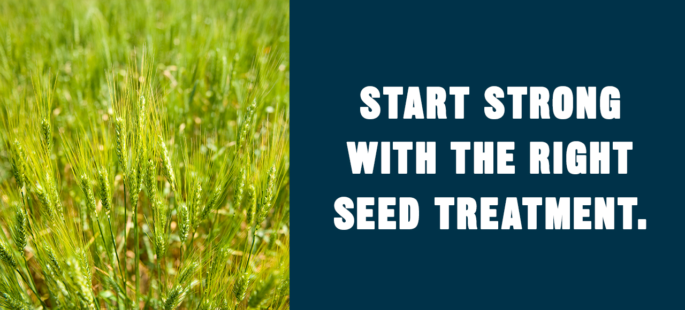
Email header

Slide 5
Topic: Winter Wheat Seed Selection
SUBJECT LINE: Winter wheat seed geared to your environment
COPY:
Expanded choices in winter wheat are yours.
Response to nitrogen. Response to population. Response to fungicide. All are critical factors to consider when choosing winter wheat seed. Now you have an expanded portfolio of options from CROPLAN® seed, with offerings that include both soft red and hard red varieties.
If you grow soft red winter wheat, you know success is all about yield potential. CROPLAN is a legacy brand in the industry for notable soft red winter wheat performance, and our portfolio includes consistent varieties you can count on. Bred for the more rugged conditions of the Central Plains wheat belt, our hard red winter wheat varieties offer top performance backed by solid data and 20 years of agronomic experience in the wheat marketplace.
Contact us to select the right winter wheat seed for your operation or to lock in your CROPLAN seed order.
Important: Before use always read and follow label instructions. Crop performance is dependent on several factors many of which are beyond the control of WinField United, including without limitation, soil type, pest pressures, agronomic practices, and weather conditions. Growers are encouraged to consider data from multiple locations, over multiple years, and be mindful of how such agronomic conditions could impact results.
© 2020 WinField United. CROPLAN® and WinField® are trademarks of WinField United.

Slide 6
Topic: Additional Resources
CROPLAN® wheat product page: https://www.winfieldunited.com/product/croplan-seed/crops/wheat/home
Article, “3 Ways to Enhance Winter Wheat Production”: https://www.winfieldunited.com/news-and-insights/3-ways-to-enhance-winter-wheat-production
Social Channel: Facebook or Twitter
  If you grow soft red winter wheat, you know success is all about yield potential. Hard red and soft red CROPLAN® winter wheat varieties offer top performance backed by solid data. Learn more: [bit.ly link]
  - Link to CROPLAN wheat product page: https://www.winfieldunited.com/product/croplan-seed/crops/wheat/home

Slide 7
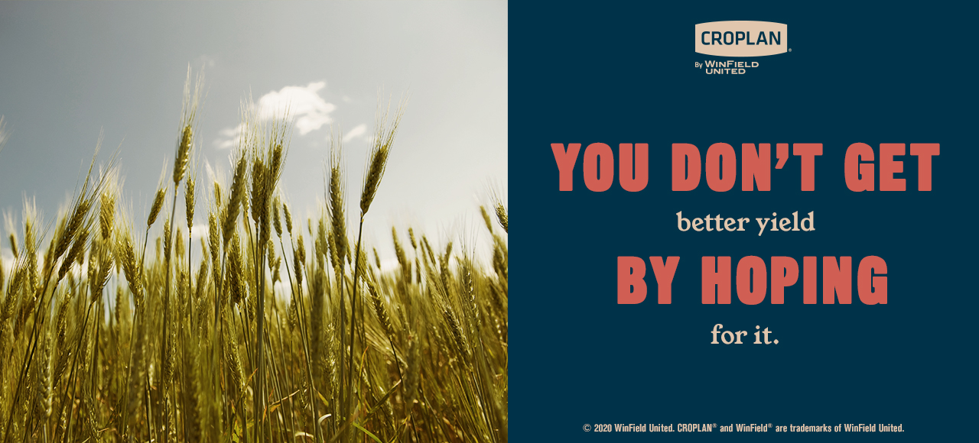
Email header

